Slide 1
Bribery over social networks
Abhinav Sen 20CS10003

Slide 2
Basics of voting
N candidates. M voters
Each voter has a preference profile which is an ordering over candidates
Candidates are scored based on a scoring rule applied on the preference profiles. Winner decided based on some condition on scores
Tiebreakers decided based on some preconceived rule

Slide 3
Basics of Bribery
Each voter has an associated cost to change one preference profile into another. These costs can be given by a function from preference profiles to R
Need more concise representations of bribery. Can define bribery costs in terms of cost to swap voters (Swap bribery), or cost to shift a voter to some amount (shift bribery)
Shift bribery can be defined by functions from [m-1] to R

Slide 4
Research Gaps
Most existing research only deals with bribery at an individual level. Does not consider the inter-relationship of voters
Consider this, would you rather bribe a difficult voter with a lot of influence on others or an easy to bribe voter with no influence?
This problem cannot be answered with conventional formulations of the bribery problem
We model the voters in the form of a social network.

Slide 5
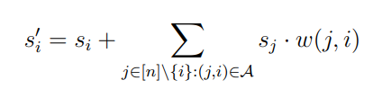
Our problem Definition
In normal shift bribery, the shift amount is just a 1 to 1 function of cost. The goal is to minimise cost to achieve some result.
Here, it is we can model the shift amount in terms of the ‘impact’ bribing voter i as well as all of the voters they are influenced by
Here si represents the ‘impact’ of our bribery individually on voter i, and w(j, i) * sj represents the impact of voter j on voter i.

Slide 6
Our problem Definition
Note that our problem statement allows us to freely model varying weights of influence between voters.
The ‘impact’ we have on every voter si has some associated cost given by a set of M cost functions.
Unlike in actual shift bribery, the s vector here does not represent anything concrete. It is a latent variable that is caused by our bribery, that then causes shifts in preference profiles.
In shift bribery, shifts are directly modelled as a function of costs. Defining it like this makes makes it possible to how to difficult it is to sway individual voters as well.

Slide 7

Problem Definition
Given a set of candidates Given a set of voters and their network Given a set of preference profiles Given a set of cost functions Given a preferred candidate c Given a voting rule
Given a budget b
Is it possible to make c win by spending a value under budget. Ie.

Slide 8
BTP 1 Results
For a complete Graph with all path weights 1, problem is polynomial time solvable with linear cost functions.
(Analogous to a situation where you have a small group of people where everyone knows everyone else, are highly influenced by each other and there is no ‘most’ influential person)

Slide 9
Algorithm
Just bribe 1 person. Choose the person with the lowest coefficient
Does not work for non linear cost functions
For the majority voting rule, We know the amount to bribe
For the plurality voting rule, a little more complicated, in the interest of time, refer report

Slide 10
BTP 1 Results
For a path Graph with all path weights 1, problem is polynomial time solvable with identical linear cost functions under the majority voting rule.
(Analogous to a situation where voters are voting one after another, and each voter can only see the next person’s vote and can be influenced.)

Slide 11
Algorithm
It is intuitive to greedily bribe the person ahead whenever possible (since si can be shifted forward with the cost for identical linear cost functions), and to not at all bribe a voter when not needed
Does not work for non identical or non linear cost functions
Formal proof for the statements present in report
Now we can generate a dynamic programming solution where we can either choose to bribe a voter i or not that runs in polynomial time (might not be the most optimal)

Slide 12
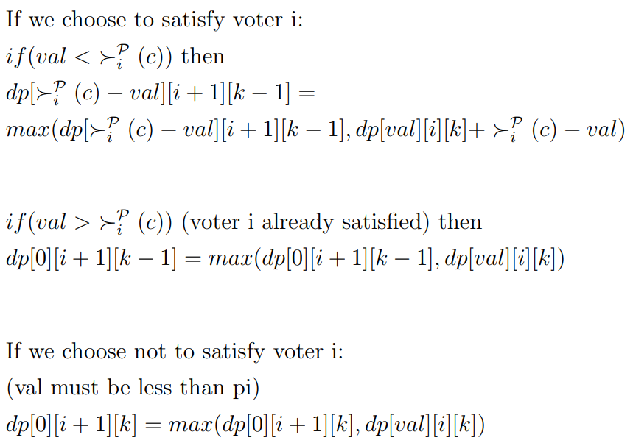
Algorithm
define dp[val][i][k] to be the minimum budget used until voter i (not included) such that there are k more voters left to achieve majority, and the value of si is val

Slide 13
Algorithm
Val cannot exceed m for any instance of the problem, which makes the dp of polynomial size. The dp can be filled by iterating in decreasing order of k, increasing order of i and decreasing order of val
The algorithm essentially takes the maximum of 2 possibilities, which have been formally proven to definitely be in the set of optimally feasible possibilities.

Slide 14
What about the general problem instance?

Slide 15
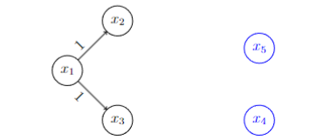
It is NP hard
We showed that the DOMINATING SET PROBLEM reduces to an instance of our given problem. Consider an arbitrary instance of the dominating set problem with n nodes, and add n-1 isolated nodes. Consider there to be only 2 candidates, for all edges to have weight 1, and for the all the voters to not vote for our preferred candidate
DSP solution exists ⇔ constructed instance has a solution
Formalised proofs present in report

Slide 16
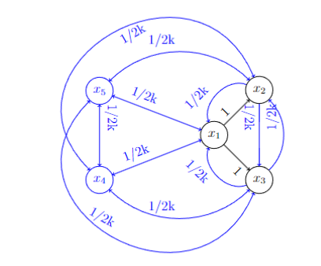
Some other hardness results
SHIFT BRIBERY OVER NETWORK is NP-complete even if all cost functions are identical, all edge weights are 1 and there are only 2 candidates (previous construction works to prove this since only these instances of our problem are constructed)
SHIFT BRIBERY OVER NETWORK is NP-complete for complete graphs and only 2 candidates (Again, reduction from DOMINATING SET PROBLEM)
Complete graph construction for reduction k = required size of dominating set
Formalised proofs present in report

Slide 17
What about trees?

Slide 18
For Trees
SHIFT BRIBERY OVER NETWORK is Polynomial time solvable on directed trees with edge weight 1, identical cost functions, and 2 candidates with a DP on trees algorithm.
1
Consider 2 candidates: 1, 2 Each voter presently has a preference profile
2
3
4
5
6
7
Formalised proofs present in report

Slide 19
DP states
Let dp1[i][b][t] be the maximum number of voters we can get to vote for our candidate in the subtree rooted at node i with at most t voters bribed.
If b = 0, voter i isn’t bribed. If b = 1, voter i is bribed. Notice that since there are only 2 candidates with edge weights 1, it provides no advantage to bribe a voter by more than 1.
Let dp2[i][b][t] be the same quantity as above, but without counting the root of the subtree.
This will be used for transitions and computing it from the previous dp is non trivial, since we need to go through children and check if they are bribed. Hence, it is stored separately.
Formalised proofs present in report

Slide 20
Transitions
Dp[2][0][t] =
2
5
6
7
Max possible votes from subtrees at 5, 6, 7 such that at most t1, t2, t3, spent in the 3 subtrees and t1 + t2 + t3 = t
This subproblem can be solved iteratively. Define knapsack functions to find max possible in first subtree, then first 2 subtrees, first 3 subtrees etc. Can be iteratively computed taking combinations from previous function and the next child
Formally, define
K(V1, V2, V3, ...Vm)[t] =
Where Vi are functions derived from children for our purposes
Formalised proofs present in report

Slide 21
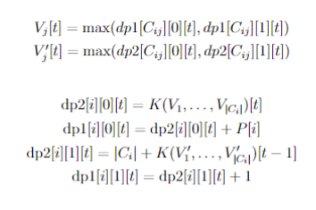
Transitions
Intuition: when root isn’t bribed, requires transitions to max values in subtree.
Else requires transitions to max values in subtree not including the child (Since children get added anyway due to bribery)
Time complexity O(nT) where T is the max number of voters that can be bribed under budget
Formalised proofs present in report

Slide 22
Some other results
A very similar algorithm works for undirected trees, just need to check bribed status of children as well during transitions (proof of why this works and implementation in report)
A correction from the report:
Claim:
For trees with non identical cost functions, the same algorithm would work, but it would be polynomial in min(sum of costs of bribing all, budget). Instead of using dp states of atmost t voters bribed in the subtree, use dp states of atmost b budget used.
This is incorrect since it may now be optimal to incompletely bribe a voter.
For multiple candidates, the proposed algorithm can be augmented to have multiple levels of bribing, but transitions would then be exponential in n due to much larger possibilities.
Formalised proofs present in report

Slide 23
Future work

Slide 24
Future work
Come up with conclusions for trees with multiple candidates and arbitrary edge weights Augment tree algorithms to work on graphs with fixed tree width
Study other specific instances of the problem for interesting properties

Slide 25
Thank you!

